Slide 1


KIET Group of Institutions, Delhi-NCR, Ghaziabad
Department of ComputerApplications
(An ISO – 9001: 2015 Certified & ‘A+’Grade accredited Institution by NAAC)
PRESENTATION ON
Drupal
SUBMITTED BY-AYUSHI SRIVASTAVA
UNIVERSITY ROLL NO:- 1900290140011
NAME :-Ayushi Srivastava
SEMESTER :- 6th
SECTION :-A
DATE:-26.02.2022

Slide 2


Slide 3
Introduction
Drupal is a free, open-source content management system (CMS) with a large, supportive community.
It's used by millions of people and organizations around the globe to build and maintain their websites.
Drupal provides a lot of flexible tools for many different tasks, depending on your focus, from end users to developers.
Drupal shines as a CMS.
Drupal provides a lot of flexible tools for many different tasks, depending on your focus, from end users to developers.

Slide 4
Features of Drupal
Drupal platform accommodates unlimited content types, including text and media content, with highly customizable forms.
It dynamically retrieves, filters, and presents this content with powerful, yet simple-to-use tools.
There are also intuitive content creation tools and powerful in-place editing tools.
Drupal is a powerful website development platform as well.
Drupal adheres to modern object-oriented programming patterns, PHP best practices, HTML5 and YAML standards.

Slide 5


Slide 6
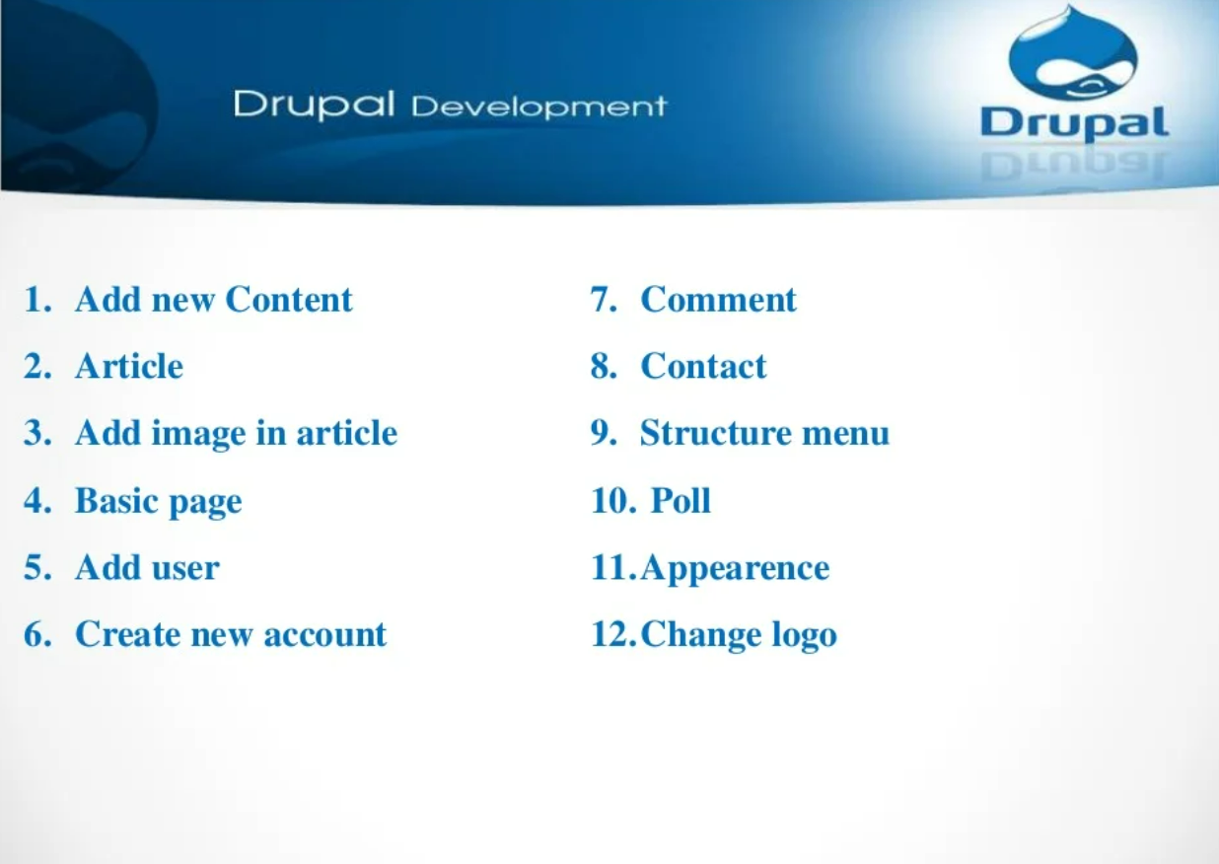

Slide 7
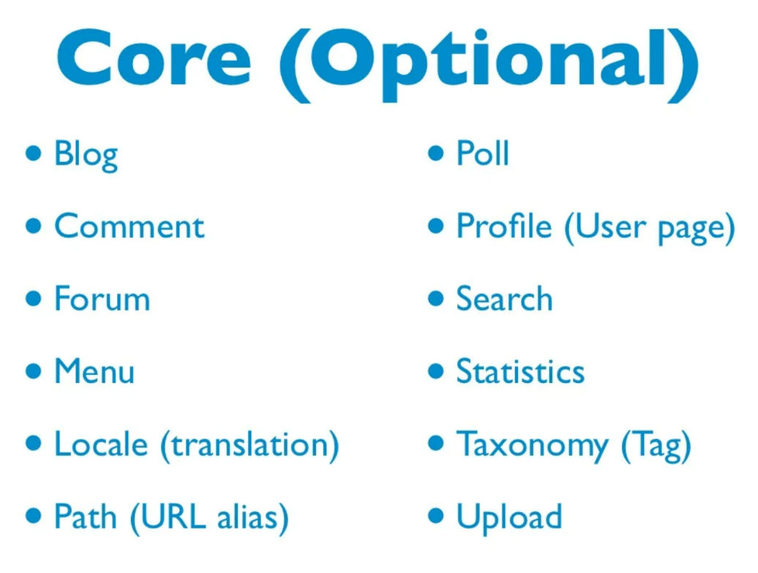

Slide 8
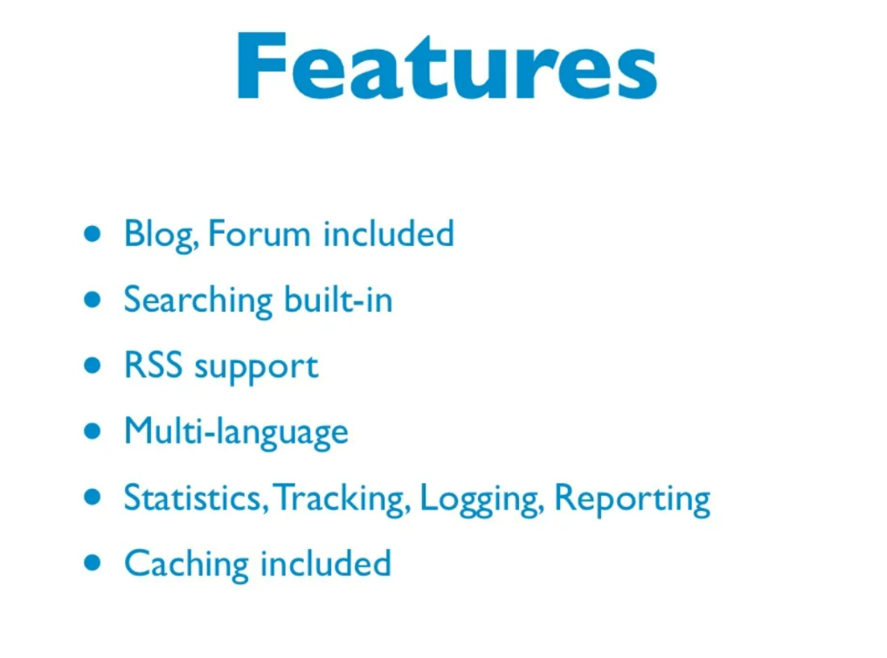

Slide 9
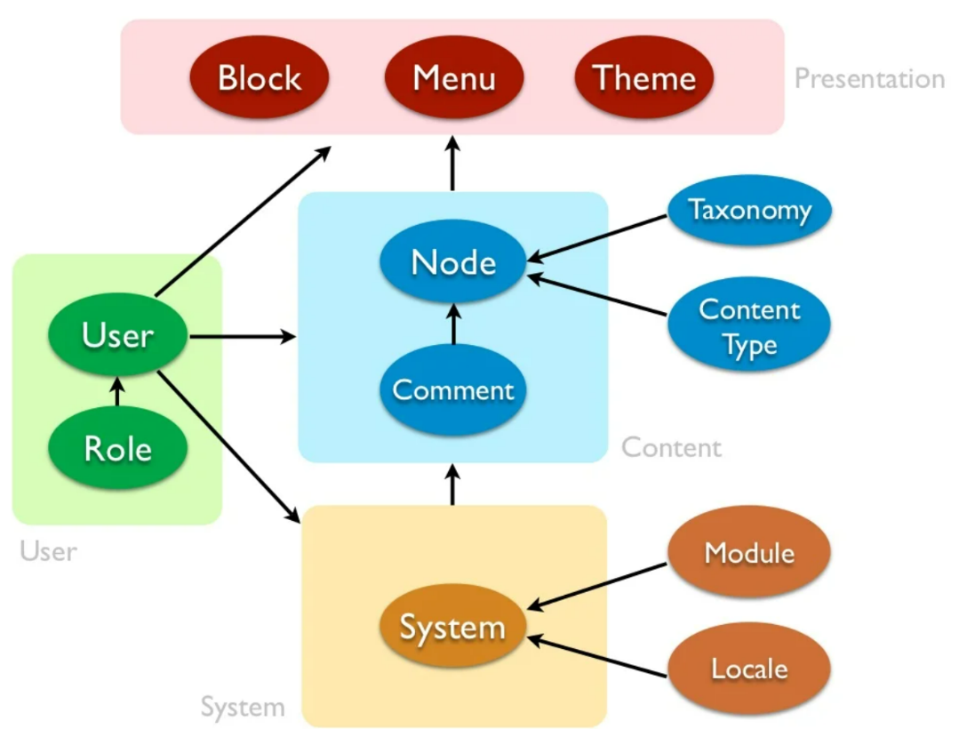

Slide 10
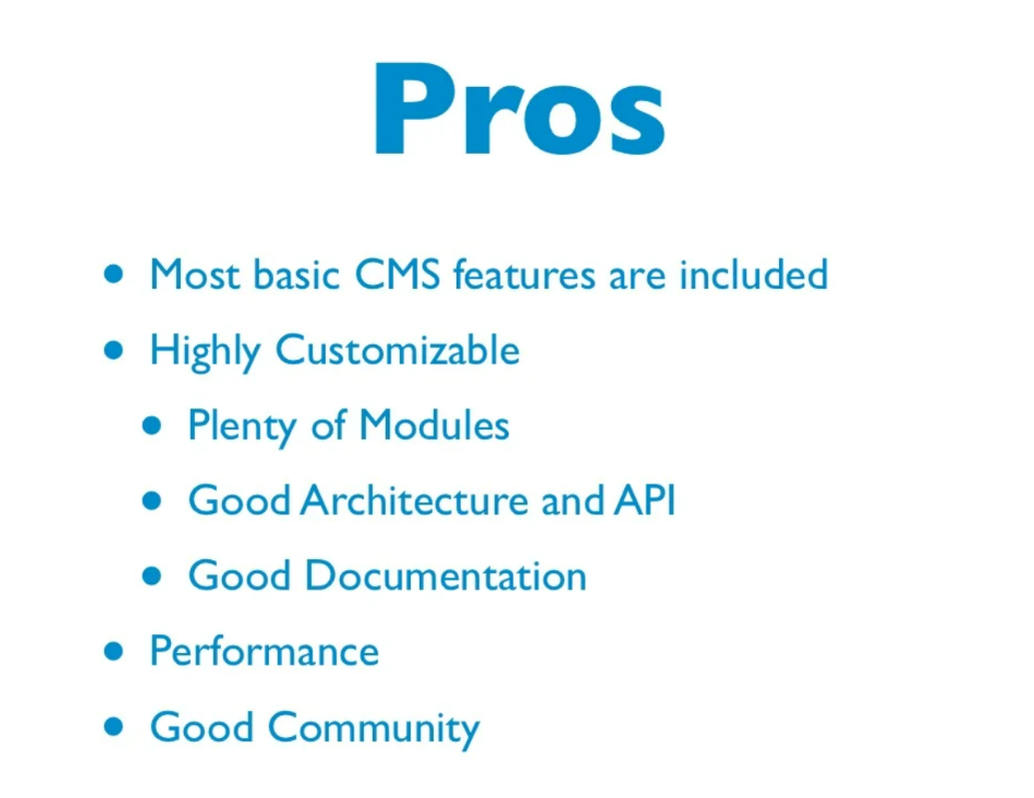

Slide 11
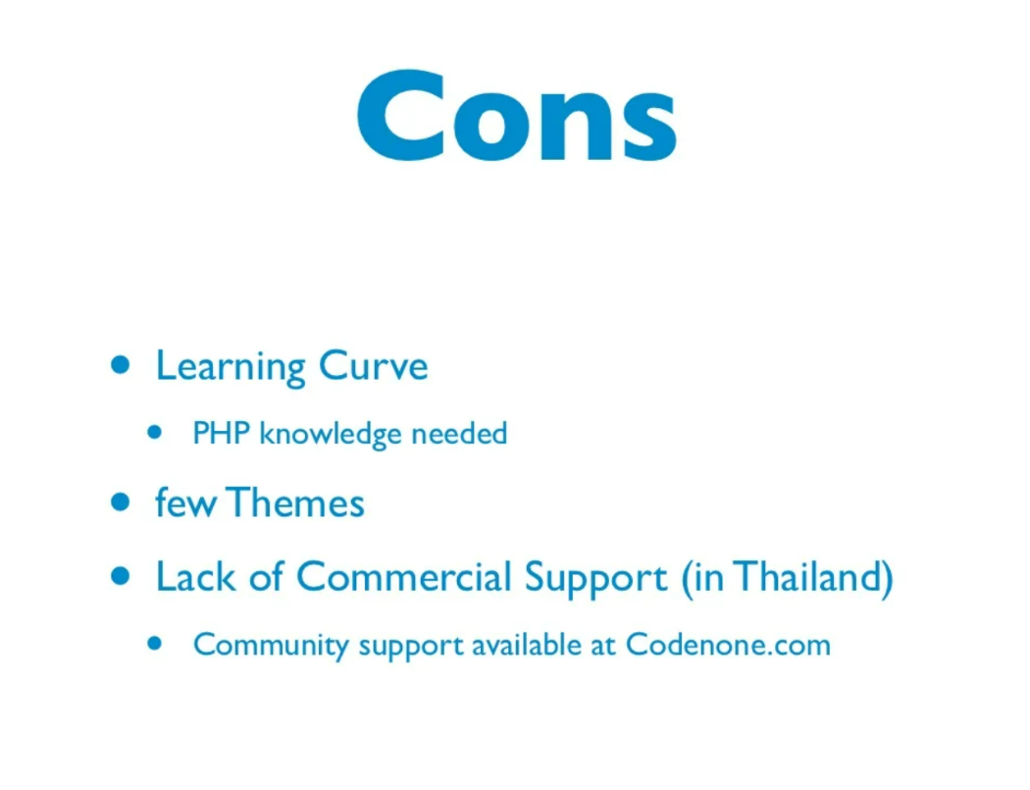

Slide 12


